Slide 1

Extended Producer Responsibility in Plastic Packaging
CENTRAL POLLUTION CONTROL BOARD
November 2022

Slide 2
Elements of EPR GUIDELINES
Notified by MoEF&CC in February 2022
( 4th Amendment to PWM Rules 2016)
  Thrust on Processing of Plastic Waste
  Annual targets for Producers/Importers / Brandowners (PIBOs) based on plastic waste introduced in market
  Obligations for Reuse, Recycle, Use of Recycle content and End of life disposal
  Key stakeholders : CPCB, SPCBs/PCCs, PIBOs, Plastic Waste Processors (PWPs)
  PWPs to issue certificates to PIBOs/ Local bodies for fulfilling EPR obligations

Slide 3

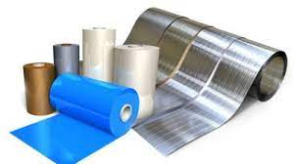
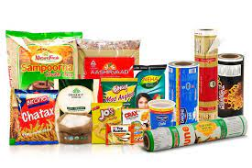
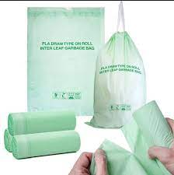
TYPES of plastics covered under EPR for plastics
Category I
Rigid plastic packaging
Category II
Flexible plastic packaging of single layer or multilayer (more than one layer with different types of plastic)
Category III
Multilayered plastic packaging (at least one layer of plastic and at least one layer of material other than plastic)
Category IV
Plastic sheet or like used for packaging as well as carry bags made of compostable plastics

Slide 4
Obligations under epr
Mandated targets specified for :
Reuse of rigid packaging ( Brand-owners) ( 2025 onwards)
Use of recycled plastic ( 2025 onwards)
Fulfilling EPR obligations through recycling ( 2024 onwards)
Compostable plastics (2024 onwards)
  Remaining EPR target to be fulfilled through End of Life Processing (Cement Kilns, Co-processing - Cement Kilns, Waste to energy and Waste to Oil.)
  70% EPR target : 2022-23; 100% EPR Target 2023 onwards

Slide 5
EPR Targets for pibos
Plastic packaging |  | Category 1 |  |  |  | Category 2 |  |  |  | Category 3 |  |  |  | Category 4
 |  | Targets as % of Annual EPR obligation
Stakeholder | Year/ Target | 24-25 | 25-26 | 26-27 | 27-28 onwards | 24-25 | 25-26 | 26-27 | 27-28 onwards | 24-25 | 25-26 | 26-27 | 27-28 onwards | 24-25 | 25-26 | 26-27 | 27-28 onwards
PIBOs | Recycling | 50 | 60 | 70 | 80 | 30 | 40 | 50 | 60 | 30 | 40 | 50 | 60 | 50 | 60 | 70 | 80
 | Recycled plastic content | 30 | 40 | 50 | 60 | 10 | 10 | 20 | 20 | 5 | 5 | 10 | 10
Brand owner | Reuse (Packaging less than 4.9 kg or liter) | 10 | 15 | 20 | 25 | NA
 | Reuse (Packaging greater than 4.9 kg or liter) | 70 | 75 | 80 | 85 | NA

Slide 6
EPR Guidelines
Registered Plastic Waste Processor (PWP) ( Recycler, Co-processor, Waste to Energy ) to issue EPR Certificates to Registered Producers, Importers, Brandowners ( PIBOs)
PIBOs to submit EPR Certificates as proof of fulfilment of EPR Obligation
Provision for exchange of EPR certificates between PIBOs / PWP
Aims at developing Business Model for collection/segregation / transportation / Processing of Plastic Waste

Slide 7
EPR WORKING MODEL
Plastic Waste
PW : Segregation & Channelization thru
Local Bodies/ WMAs/ Others channels
Plastic Waste processors
EPR Certificates
Producers, Importers, Brandowners
Centralized EPR Portal launched by CPCB on April 05, 2022

Slide 8
PIBOs REGISTRATION STATUS
 | CPCB | SPCB | Total | ( 23.8.22) | % Change
Received | 1656 | 2858 | 4514 | 2622 | 72
Registered | 1544 | 1906 | 3450 | 1816 | 90
In Progress | 47 | 611 | 658 | 354 | 86
Not Approved | 65 | 341 | 406 | 452 | -10

Slide 9
REGISTRATION STATUS: PLASTIC WASTE PROCESSORS
 | PWP | 23.8.22 | % Change
Received | 1632 | 537 | 204
Registered | 1279 | 254 | 404
In Progress | 234 | 37 | 532
Not Approved | 119 | 236 | -50

Slide 10
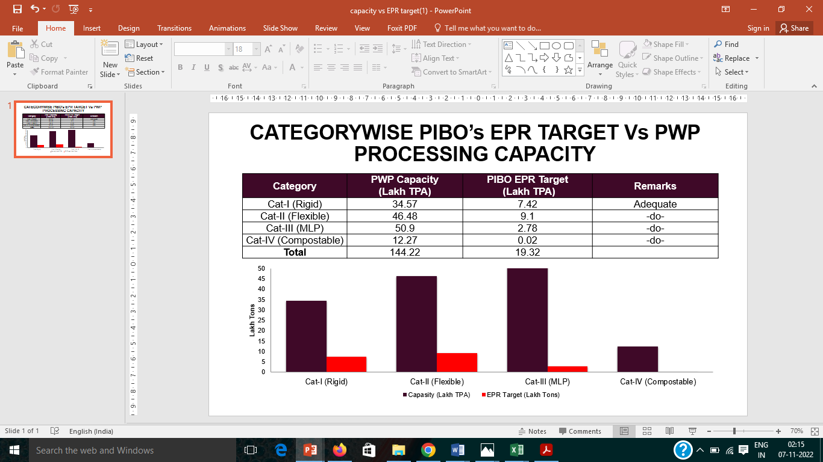
CATEGORYWISE PIBO’s EPR TARGET Vs PWP PROCESSING CAPACITY

Slide 11

Seven Modules of EPR Portal
Module- 1 : Registration of PIBO
Module- 2 : Registration of PWP
Module- 3 :Issue & Exchange of EPR Certificate
Module- 4 :Filing of Annual return
Module- 5:Environmental Compensation
Module- 6 :Third Part y Audit
Module- 7:Training
Module 1 & 2 operational
Module 1 A & 3 are being launched today

Slide 12
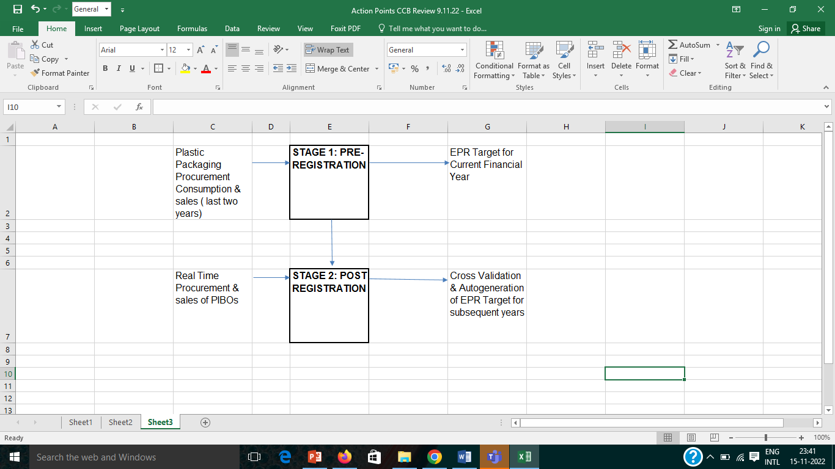
Information Flow for Module 1 A

Slide 13
Module 1 A
PIBOs at the time of filing application shall provide the details related to plastic packaging sales, consumption as well as procurement,
The EPR target for the current operational year is calculated on the basis of information for the last two years submitted with the Application
For subsequent years, PIBOs shall be required to provide real-time information of sales & procurement, on the basis of which EPR target shall be auto-generated as per EPR Guidelines,

Slide 14
KEY FEATURES
Real time Capture of Procurement /Sales of Plastic Packaging
Cross validation of Transactions between PIBOs/PWPs
(Invoice No. generation / Auto-population of Sales/ Procurement detail)
Dynamic fixing of Annual EPR Target as per EPR Guidelines
(Auto-generation of next year EPR target)
Facilitating error free filing of Application
( Cross validation of input data/ Integration of APIs/ Late fee mechanism)
Provison built in to carry forward reuse / Urep target

Slide 15
Stage 1(Pre-registration) :It covers operations prior to registration and includes Sign up & submission of Application for Registration
Stage 2( Post Registration ) : It covers operations to be carried out post Registration including providing real time information of procurement & sales. Validation of transactions between PIBOs/PWP, assessment of the quantity of recycled plastic used as well as that of reuse of Cat I plastic packaging, is done on the basis of the real time data.

Slide 16
Stage I : Preregistration Type
Brand-Owner/Producer/Importer/ PlasticWasteProcessor
(ii)CompanyDetails:Followinginformationtobeprovided
Legal/ Trade Name ( As per GST) Type of Business( Private/Public/ Proprietorship/ Co-operative etc.) Type of Company ( Micro/ Small / Medium / large) Registered Address of the entity Company PAN/ CIN ( Mandatory for companies registered under the Company Act and validated on the Portal) ( PAN /GST API also being integrated)

Slide 17
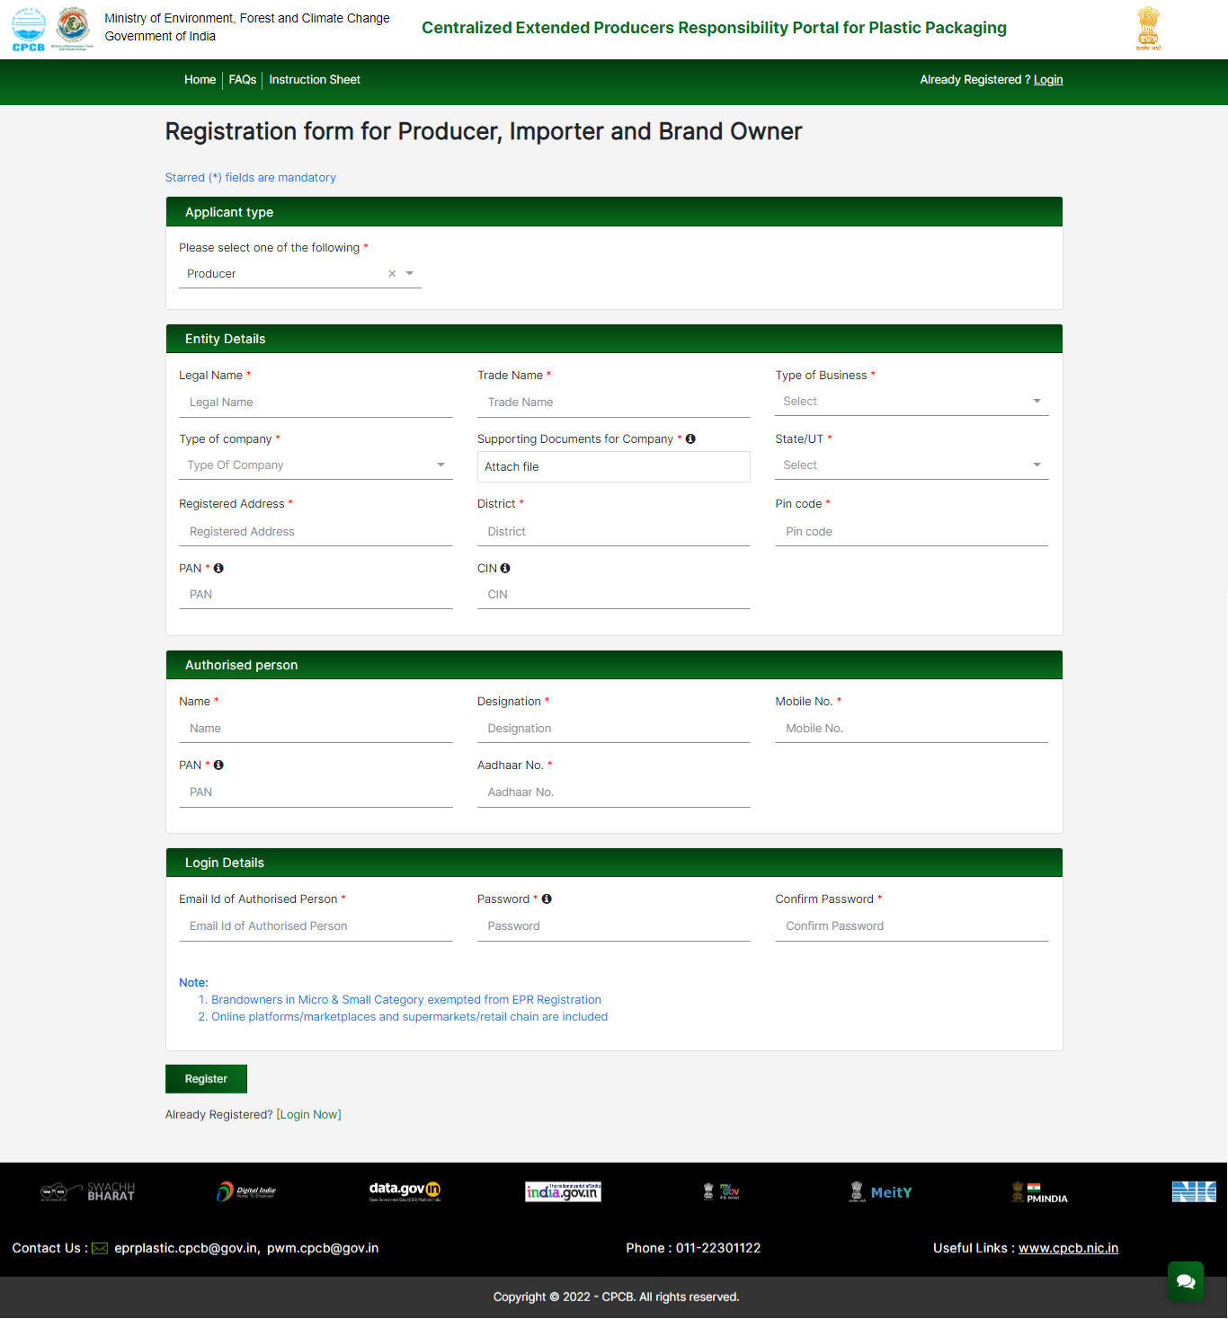
Signup for Registration of PIBOs

Slide 18
Filling up of the Application Form
Part A: General Information
      States/UTs where the PIBO is operational
      Confirmation, if the PIBO , has a production facility
      Year of Commencement of Operations
      Details of products produced
      Representative Picture of Plastic Packaging /Plastic Packaging for Commodities covering different Categories
      Category-wise Plastic packaging consumed in the last two years ( Section 5c)
      Confirmation that the PIBO is not using / producing /selling banned SUP items
Checks & Balances: If year of commencement of operation is previous to the current year, the portal shall not accept applications zero plastic waste consumption( Section 5c) and waste generation ( Section 7)

Slide 19
PART B( Pertaining to Liquid Effluent & Gaseous Emissions)
  Consent API integrated. The user will have to key in the Consent Application No. which will autofetch the date of validity of the Consents (Air/ Water Act)
  The user shall be able to proceed further with filing of application only if the Consents under Air & Water Act are valid on the date of filing of application.

Slide 20
PART C: Related to Wastes
  Statewise/ categorywisePreconsumer& Post consumer plastic packaging waste, recycled plastic content is to be provided for the last two years in Section 7 of the application
  The user can click on “Save” after keying in data for each row to avoid losing data
  Pop-up Message shall be flashed if there is a discrepancy in the data
  Checks & Balances: Category and year wise quantity of Total Pre and Post consumer plastic waste provided in section 7a should be less than or equal to the details provided in section 5c.

Slide 21
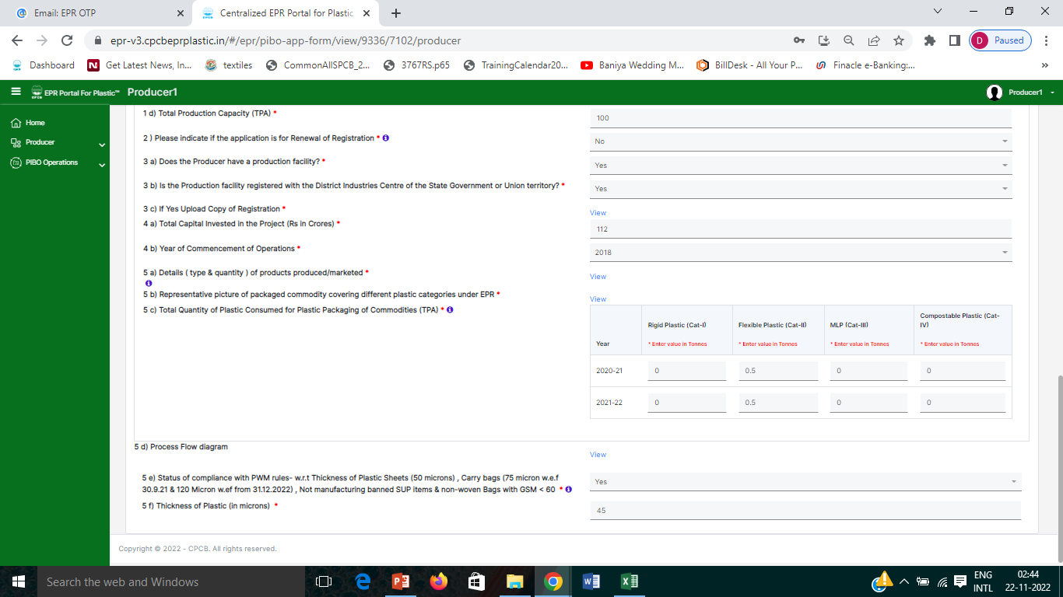

Slide 22
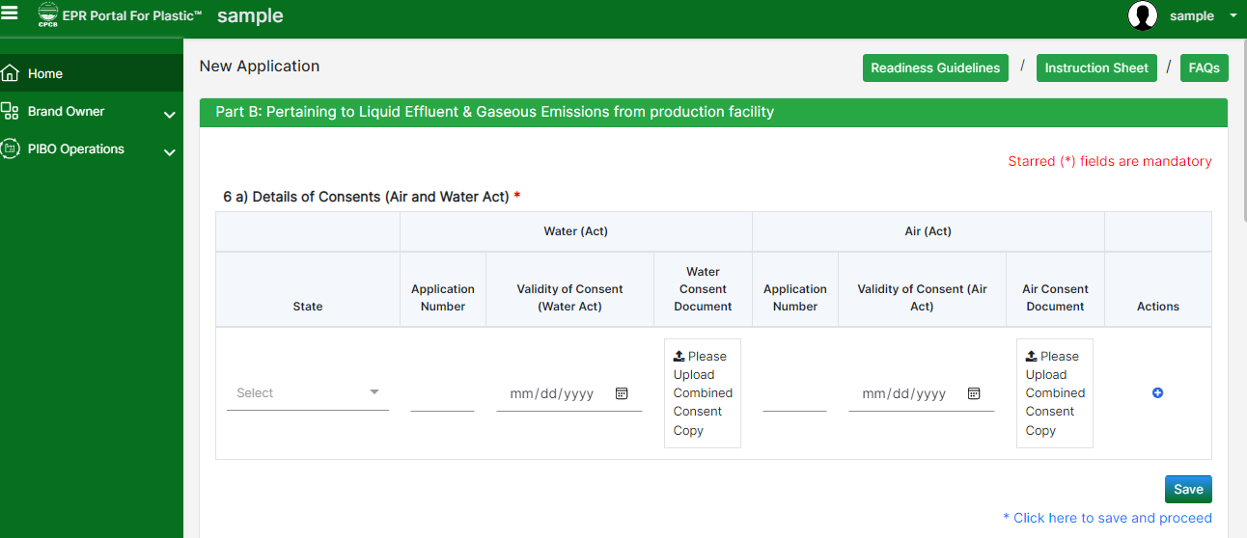
Part B: Pertaining to Liquid Effluent & Gaseous Emissions

Slide 23
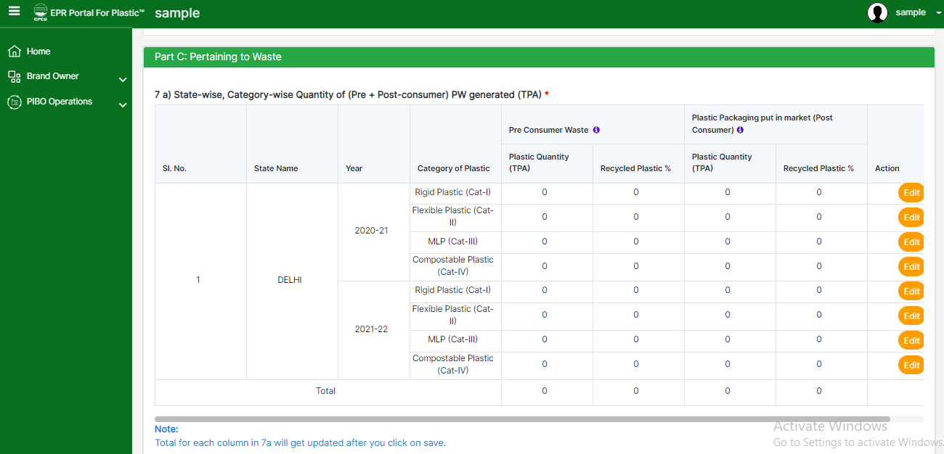
Part C: Pertaining to Wastes ( Section 7)

Slide 24
Part C- Section 8: Filling of Procurement & SalesDetails
The various details which have to be provided include:
Name of entity, Address, Mobile No
Year of procurement ; Plastic material Type
Category of plastic (for CAT-I container size( >09L and <4.9L, >4.9L &<0.9L)to be selected)
GST details of seller; Total quantity to be procured
Percentage of recycled plastic;
Invoice No.
  Plastic packaging can be procured from Registered as well as unregistered entities
  In case of procurement from Registered entity “Invoice Number” generated from EPR Portal is to be keyed in and details shall be auto populated.
  In case of procurement from Unregistered entity details as required is to be keyed in
  GST invoice is to be uploaded wherever applicable as per GST Act 2017 ( as amended)
  Checks & Balance : Section 8 data should match with Sec 7

Slide 25
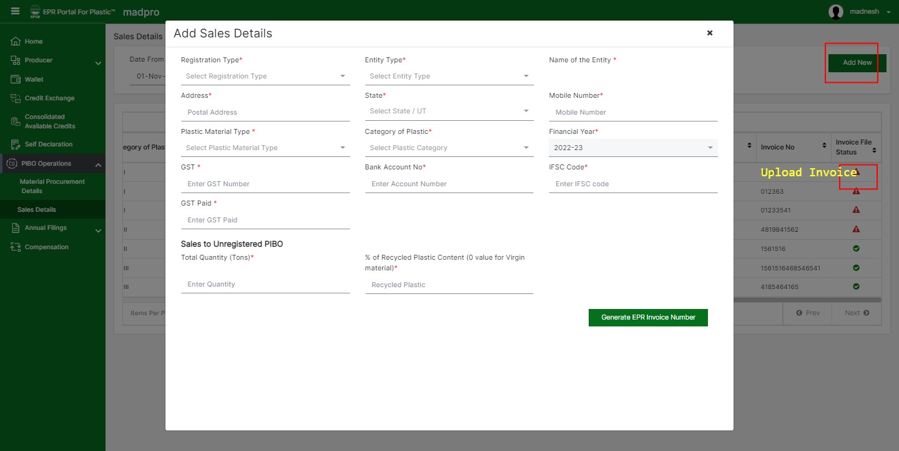
Sales details and invoice generation

Slide 26
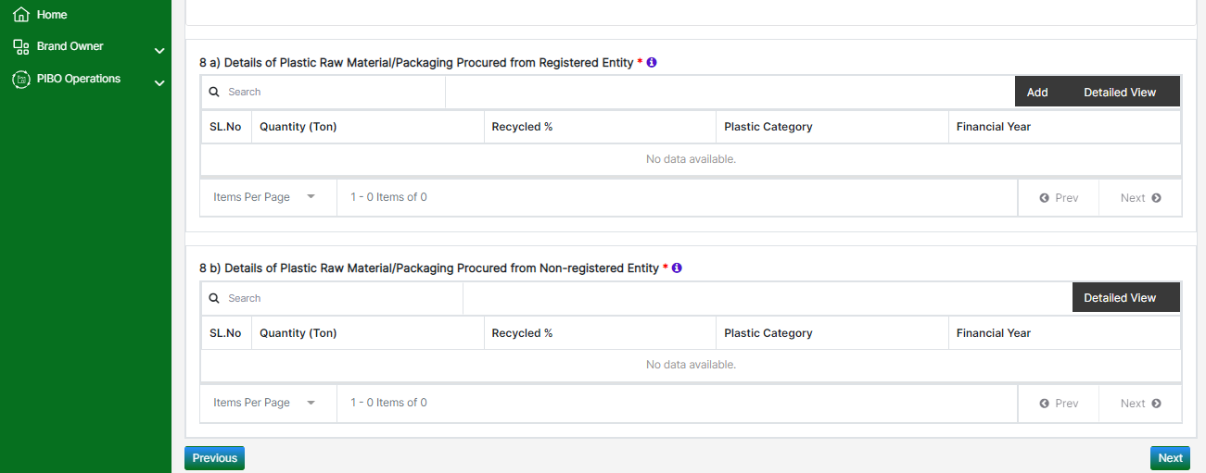
  Part C ( Section 8) – Plastic Packaging Procurement

Slide 28
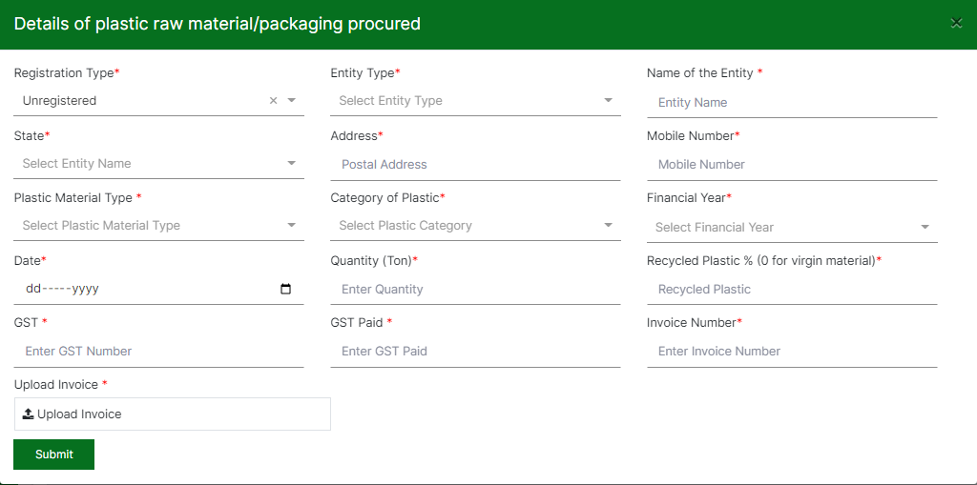
Procurement Details (Unregistered entity)

Slide 29
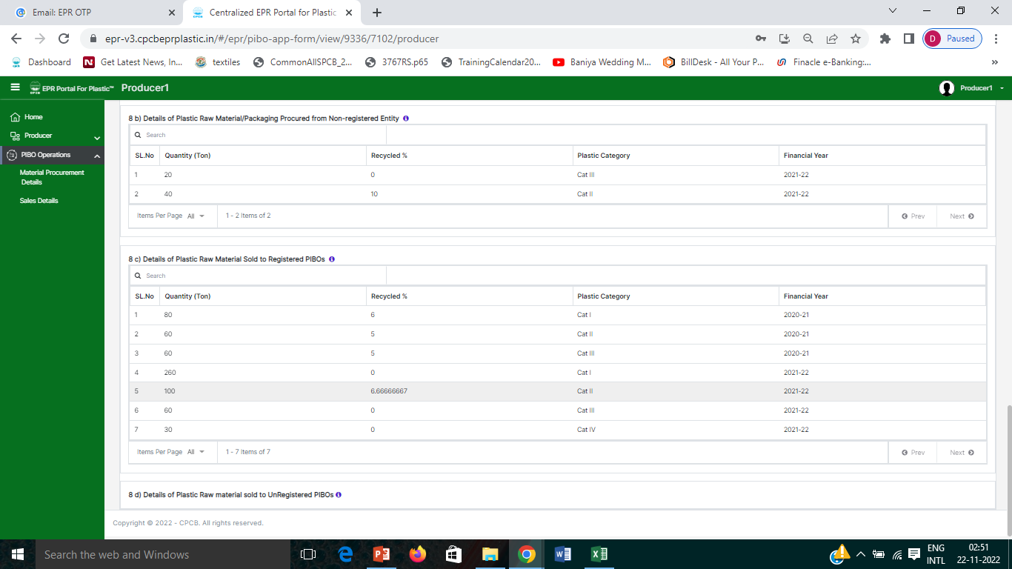

Slide 30
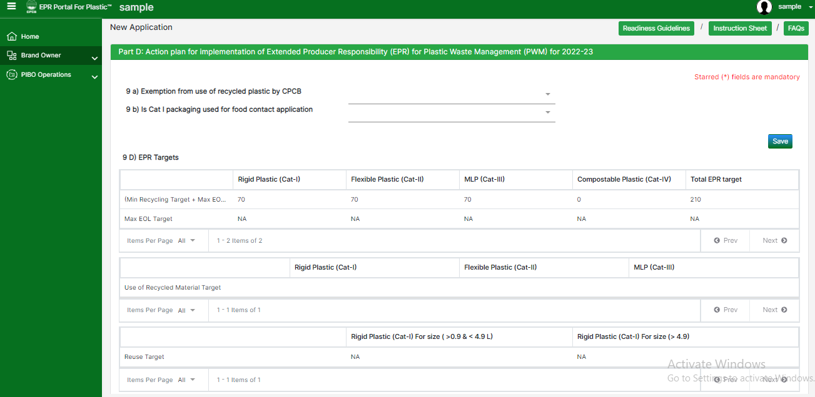
PartD:EPR target
      Category wise EPR Target Auto-generatedon the Portal based on information provided in the Application

Slide 31
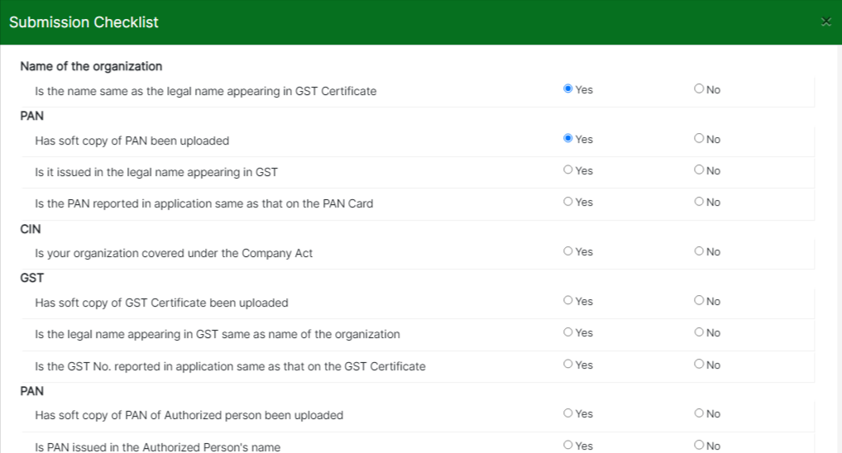
Checklist
The user shall fill in the Checklist prior to filing the application to ensure filing of error free application

Slide 32
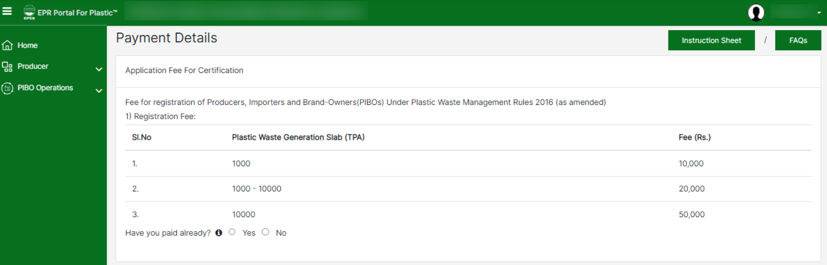
Payment of Application Fees
Payment of Application Fees

Slide 33
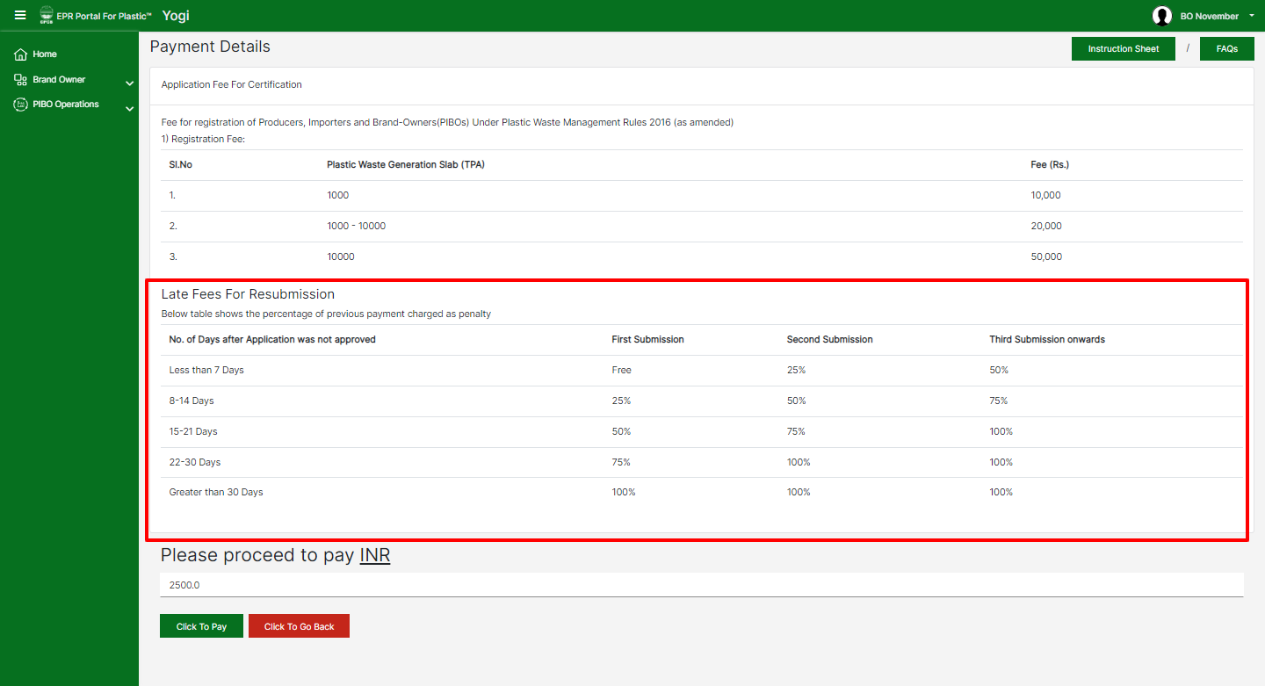
Late fees Mechanism

Slide 34
STAGE II: POST REGISTRATION OPERATIONS OF PIBOs
Real time procurement / sales transactions are to be recorded on the portal by Registered Entities
Entries have to be made for the current financial year .

Slide 36
Sales details and invoice generation

Slide 37
In case of material transaction between registered PIBOs & PWPs, details of procurement shall be auto populated in buyer section once invoice is generated by seller.
In case of material transaction between unregistered PIBOs, following details need to be keyed in
Name of entity, Address, contact no.
Plastic material Type, Category of Plastic
Category of plastic
GST details of seller
Total quantity to be sold
Percentage of recycled plastic content
Invoice No.
Document required :PDF copy of invoice issued to the seller to be uploaded .

Slide 38
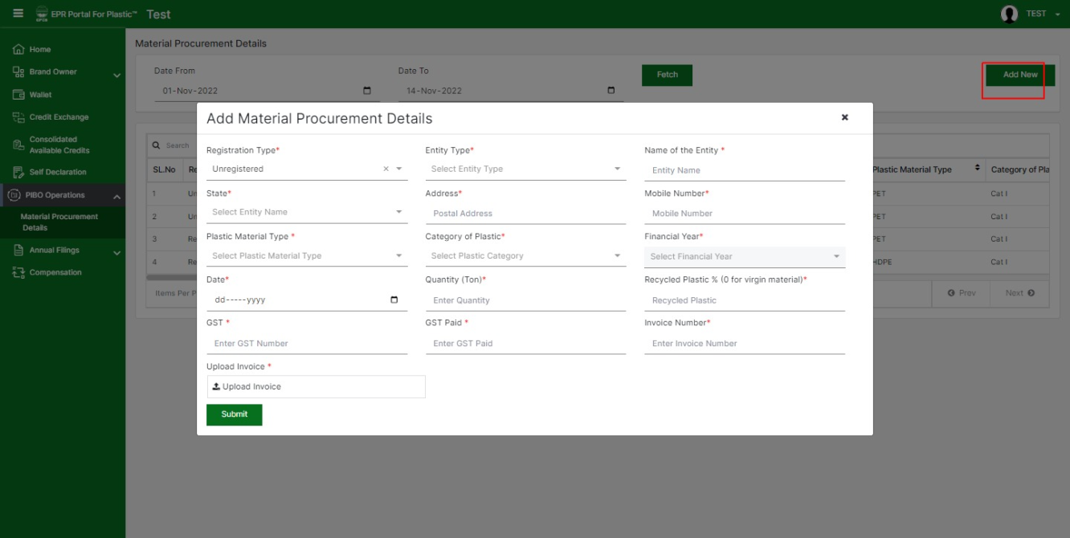
Procurement details Unregistered Entities

