Slide 1
MODULE III
Generation & Transfer of Certificates by Plastic Waste Processors
Module III comprises of two Sections
Section 1: Physical Verification of PWPs by SPCBs/PCCs
Section 2: Generation & Transfer of Certificates by PWPs

Slide 2
Steps involved in Physical verification:
Step 1: Creation of Login Credentials of SPCB/PCC’s Regional office(RO) by Designated Officer(DO)
Step 2: Assignment of Registered PWP by DO to concerned RO for Physical verification
Step 3: Conduction of onsite physical verification by RO & Online Filing of Checklist by RO
Step 4: Communication of Recommendations of RO to DO
Step 5: Approval /Rejection of Physical Verification of PWPs by DO based on RO’s recommendations
Step 6: Activation of Certification Generation function of PWP based on approval of Physical Verification

Slide 5
2.0 Generation & Transfer of EPR Certificates by PWPs
(a) Plastic Waste Procurement
(b) Production
(c) Inventory & Sales
(d) Wallet : Certificate Potential, Generation & Transfer
The PWPs can generate certificates of various denominations of 1, 10, 50, 100, 500 & 1000 T based on requirement and transfer it to PIBOs

Slide 8
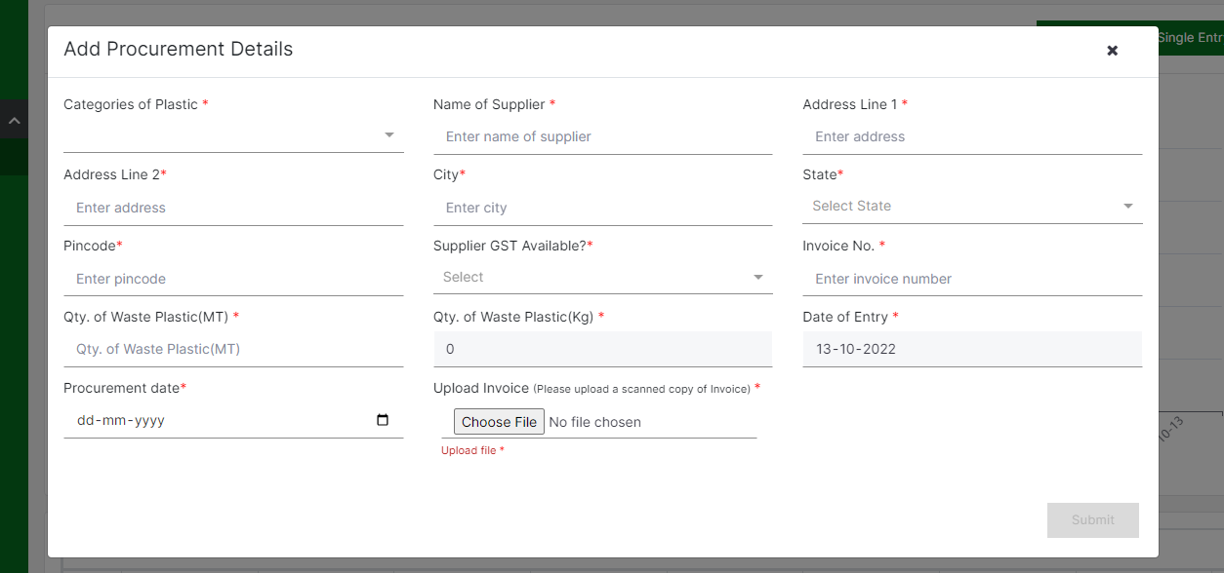
Performa for Addition of PW Procurement details

Slide 13
Checks & Balances in Production Section
  Adequate entries for PW procurement should been made prior to production. There shall be a deduction in the procured waste quantity corresponding to its consumption in Production Section. Eg: If production shows 100 T of Plastic waste, then procurement equal or more than 100 T should have been made. Further, if a procurement of 200 T of Plastic waste has been made and 100 T of plastic waste has been consumed in production , then available plastic waste after production shall be 100 T.
  PWP Process Code shall be as per the Registration granted. The plastic waste processed & the product manufactured are linked with the Process code for which the registration is granted. For example , if a PWP is registered under R1 Code( Recycler – Cat 1 Waste to Pellets/Chips ), then the processing shall be restricted to Category 1 Plastic waste and production shall be limited to pellets and chips

Slide 14
Checks & Balances in Production Section
  Cumulative Plastic Waste Processed should not exceed Processing capacity as per Registration. For example, if the processing capacity of the unit is 1000 T of plastic waste, then processing of plastic waste cannot exceed 1000 T during the financial year.
  Type & Quantity of Product to be limited by the Production capacity as per the Registration granted. For example, if production capacity of unit is 800 T of pellets, then production of pellets cannot exceed 800 T during the financial year

Slide 15
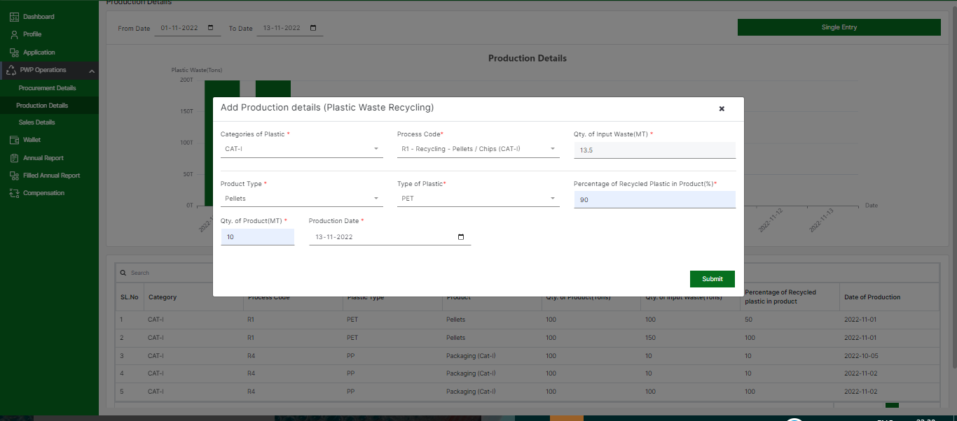
Performa for filing Production details ( Recycler)
Figure: Proceeding to “Production Section”
Similar Performa proforma for WtE/ WtO & Coprocesssor

Slide 16
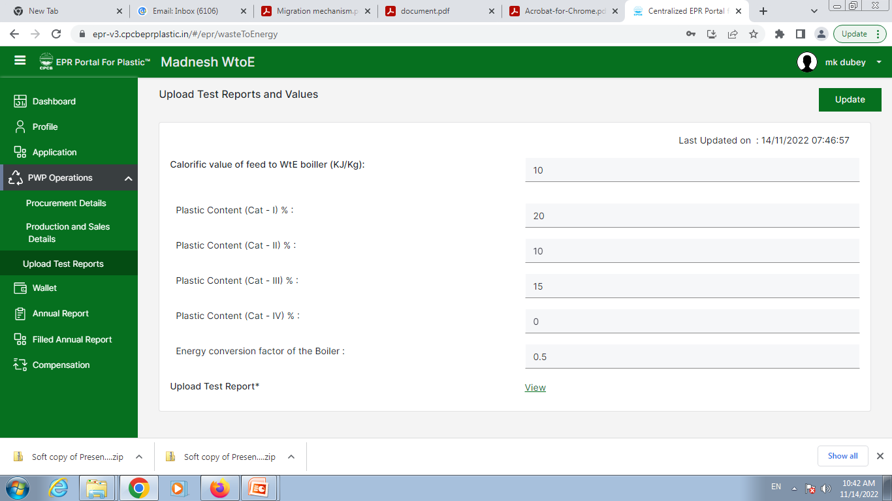
Proforma for Test Report ( WtE)

Slide 19
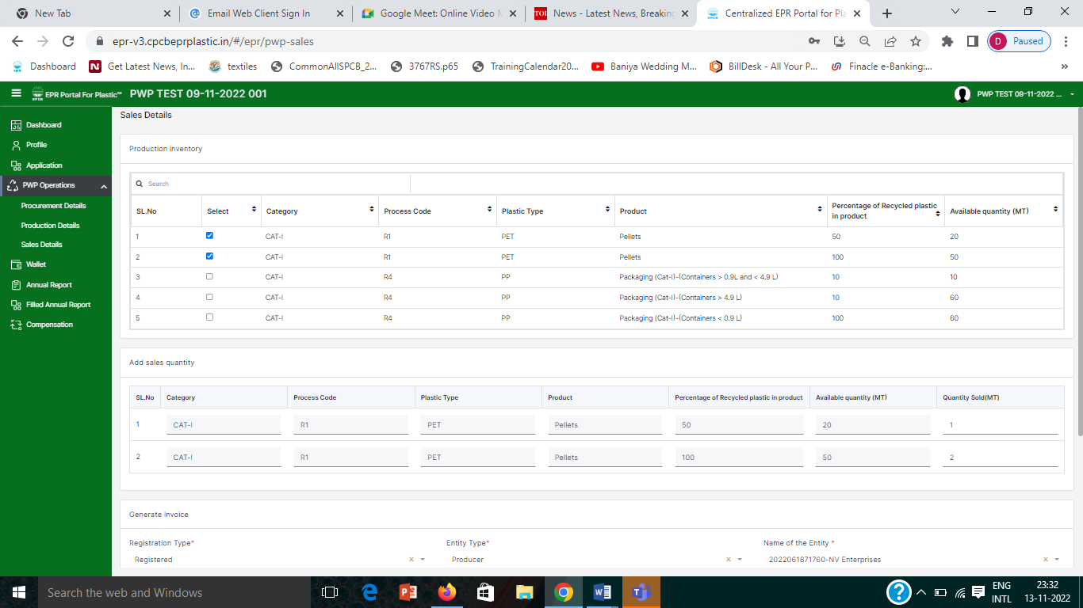
Inventory Details ( Recycler)

Slide 20
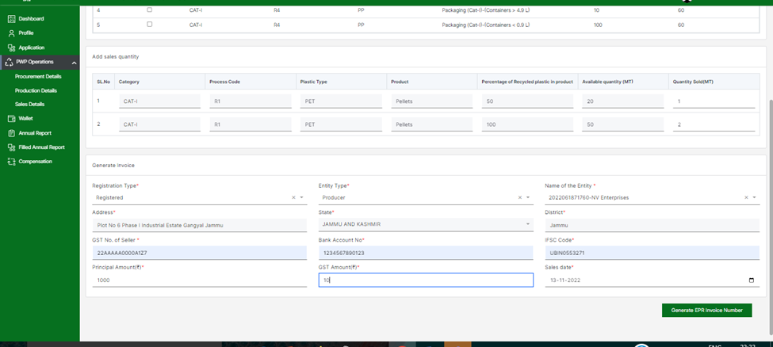
Performa for Generating Invoice (Recycler)

Slide 21
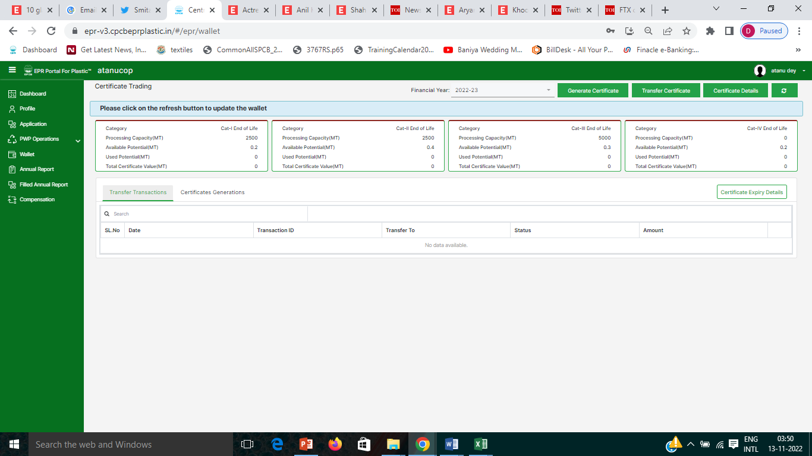
Step 4: Wallet:
Available / Used Certificate generation potential corresponding to the sales for different categories of Waste shall be displayed
Certificate Generation: The PWP can generate Certificate by clicking on “ Generate Certificates” Certificates of different denominations ( 1, 10, 50, 100, 500 & 1000 T)
Certificate Transfer: The PWP can transfer the generated certificates by clicking on “ Transfer Certificate”
Certificate Details: The PWP can view details related to generated, transferred & available certificates in this section by clicking on “Generated”, “Transferred “ & “Available” in this section. Certificate details (ID / Category/ Value/ Type/Cumulative, Used & Available Potential/ Time of generation, validity etc) can be viewed in this section.

Slide 22
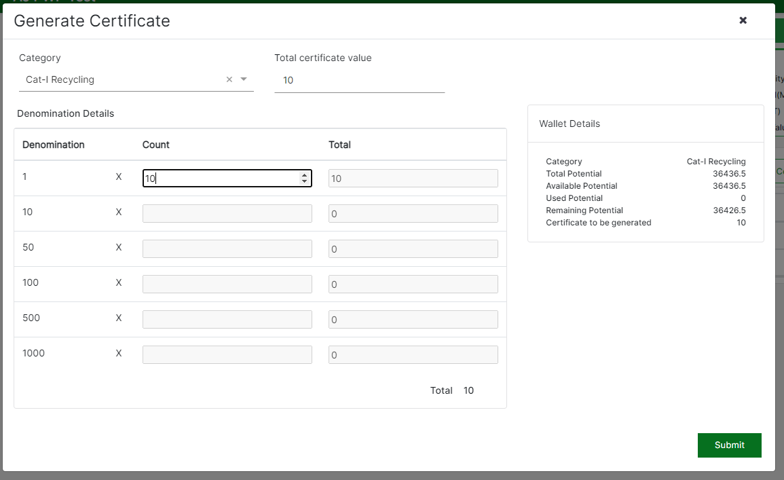
Generate Certificate

Slide 23
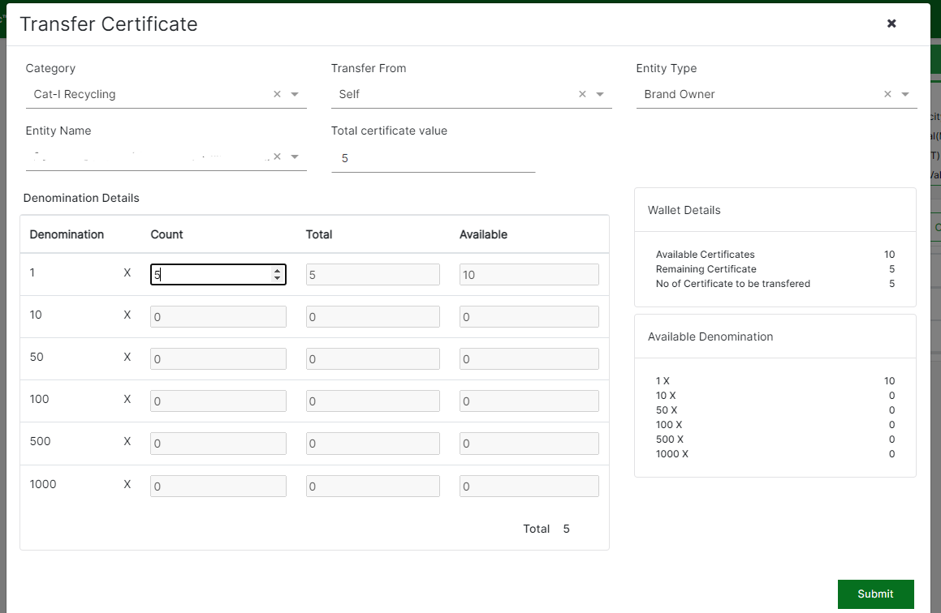
Transfer Certificate

Slide 24
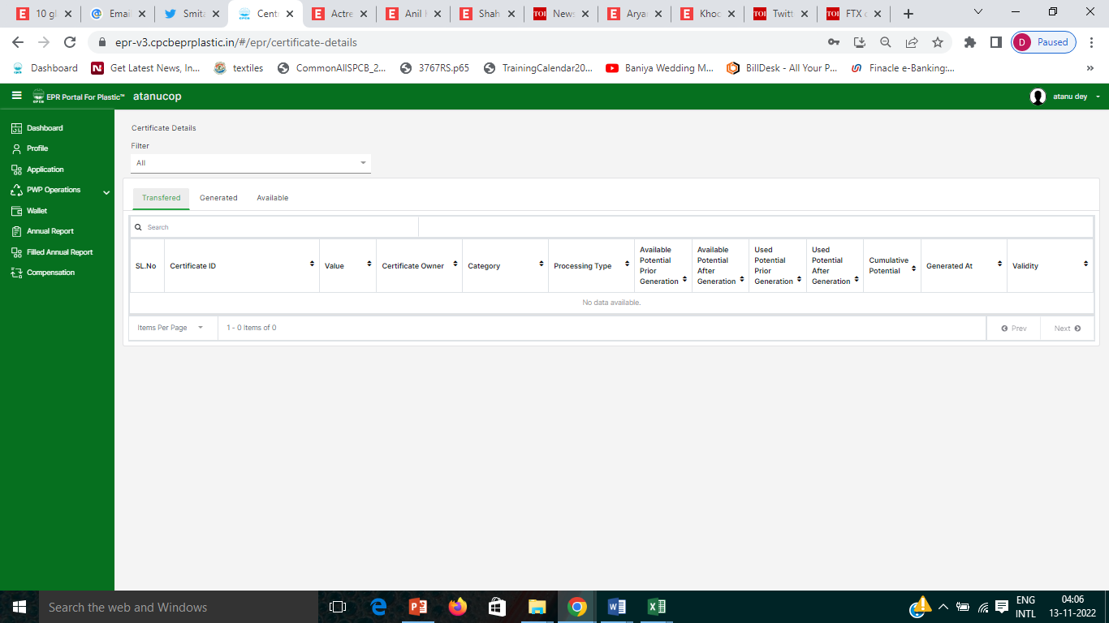
Certificate Details
Certificate Generation & Transfer on the Portal
Each Certificate has Unique Attributes
Transfer details can be tracked on the Portal
Validity three yrs; Shall be extinguished when used for filing Annual returns

